Slide 1
Tableau visualization
Jerin Joseph

Slide 2
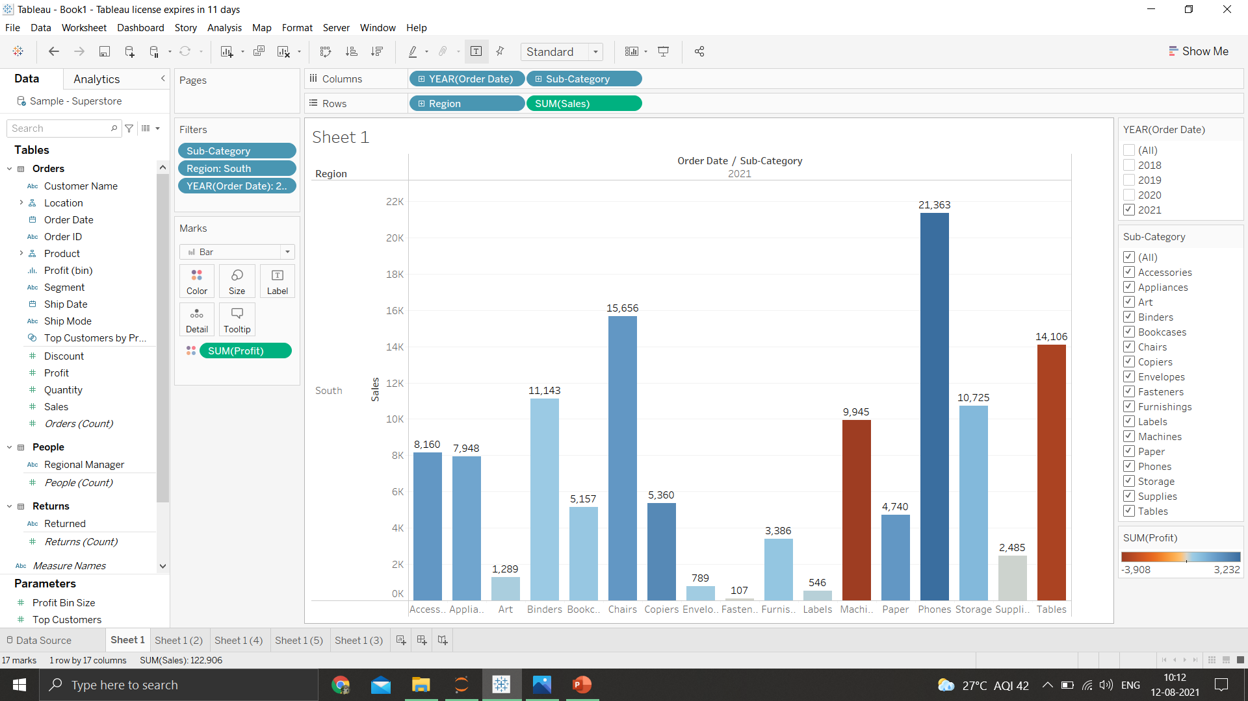
1.Find the profit & sales for each sub category of every type of product

Slide 3
2021
Accessories had profit 1947 & sales of 8160
Appliances had profit 1512 & sales of 7948
Art had profit of 279 & sales of 1289
Binders had profit of 406 and sales of 11143
Bookcases had profit of 514 & sales of 5157
Chairs had profit of 193 & sales of 15656
Copiers had profits of 2382 & sales of 5360
Envelopes Had profits of 336 & sales of 789
Fasteners have profits of 42 and sales of 107
Furnishings have profits of 569 and sales of 3386
Labels have profits of 336 & sales of 789
Machines have profit of -3908 & sales 9945
Paper had profits 1936 & sales of 4740
Phones Have profit 3232 & sales of 21363
Storage have profit of 992 & sales of 10725

Slide 4
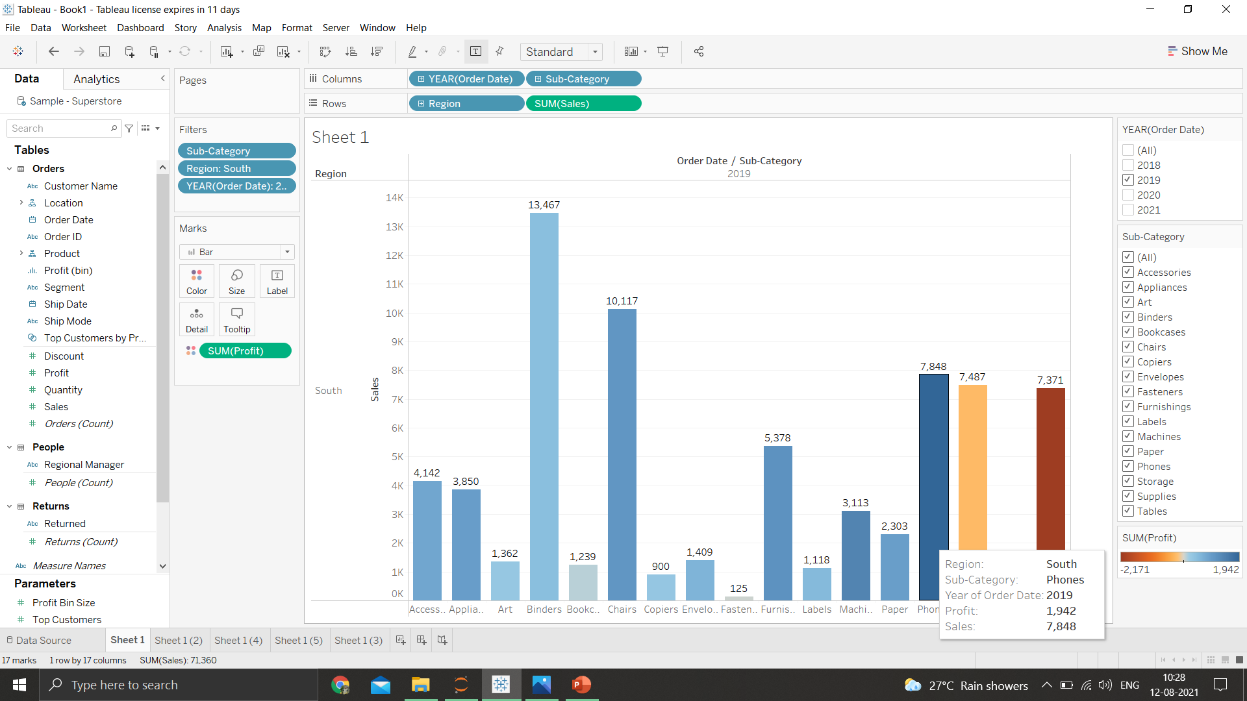
2.Which subcategory has the highest profit in the year 2019
Phones have the highest profits of 1942 in the year 2019

Slide 5
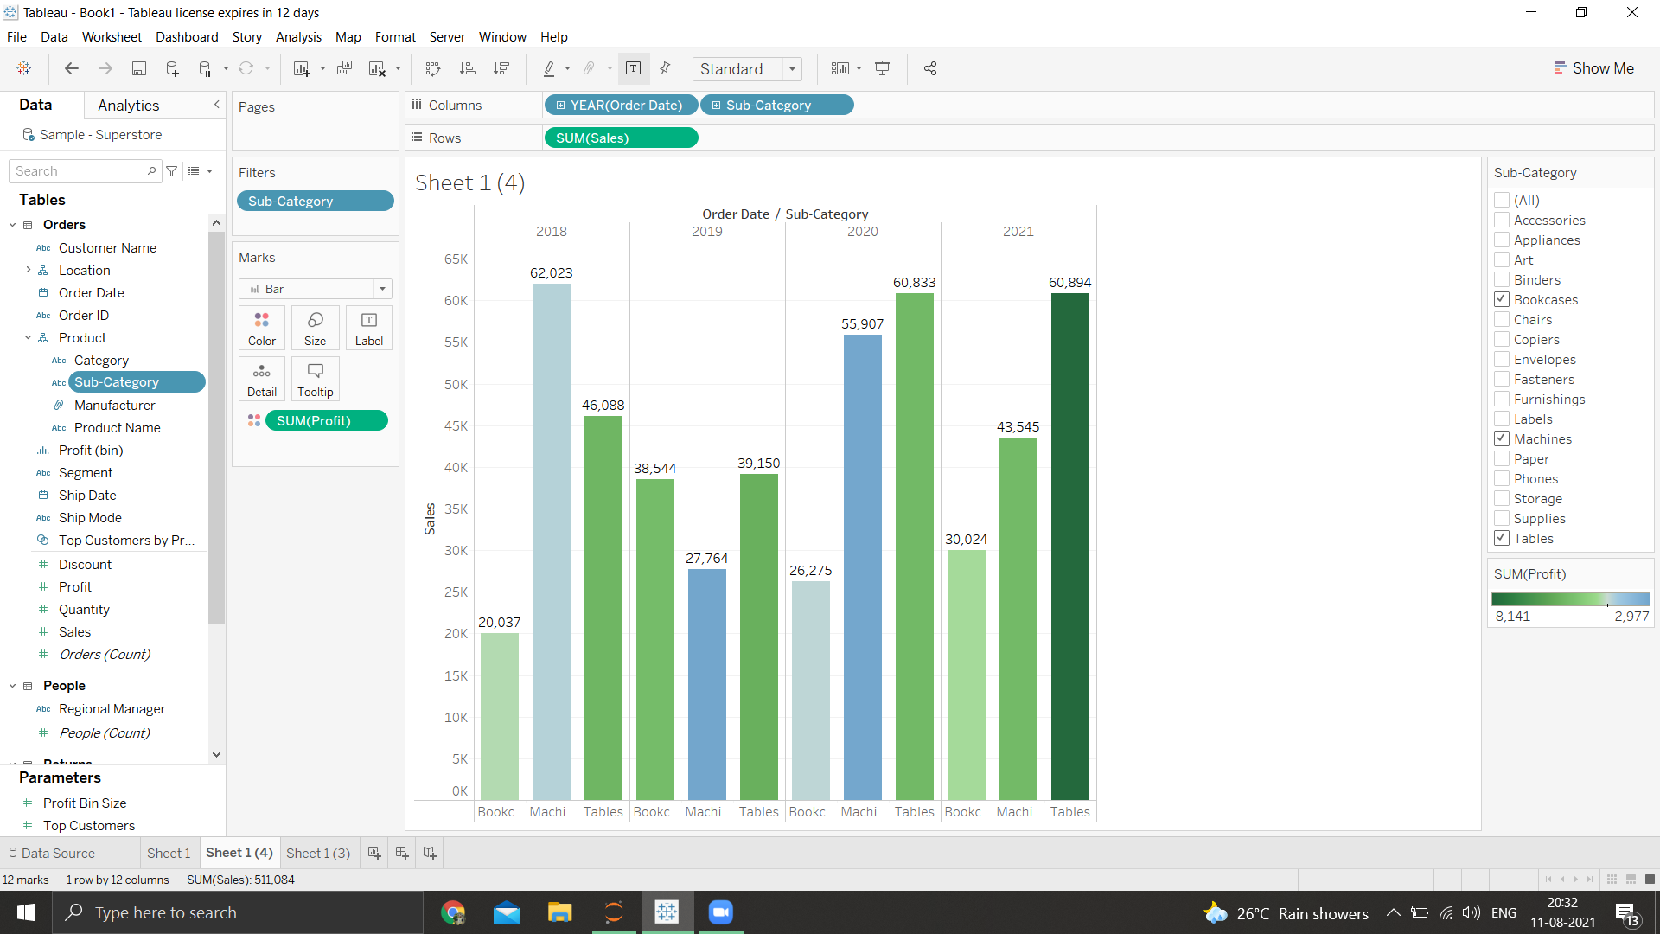
4.In the view, in the sub category filter card ,clear all of the check boxes except bookcases ,machines and tables to have closer look on each value

Slide 6
5.Find out the key insights about in which year bookcases & machines were profitable & unprofitable
In year 2018,the profit for bookcases were 165 & the profit for machines were -3254
In year 2019,the profit for bookcases were 108 & the profit for machines were 1415
In Year 2020,the profit for bookcases were 553 & the profit for machines were 4308
In Year 2021,the profit for bookcases were 514 & the profit for machines were -3908
Overall we can say that there is steady growth in bookcases but a strong push should be done for the marketing and advertising for these products,because there is a year on year sales increase of 100%
Overall the sales have been dwindling downward from 2018 & never has reached the levels of 2018 on top of that the overall profit is a -1439 which says that the business model of the machines have to be changed in order to survive

Slide 7
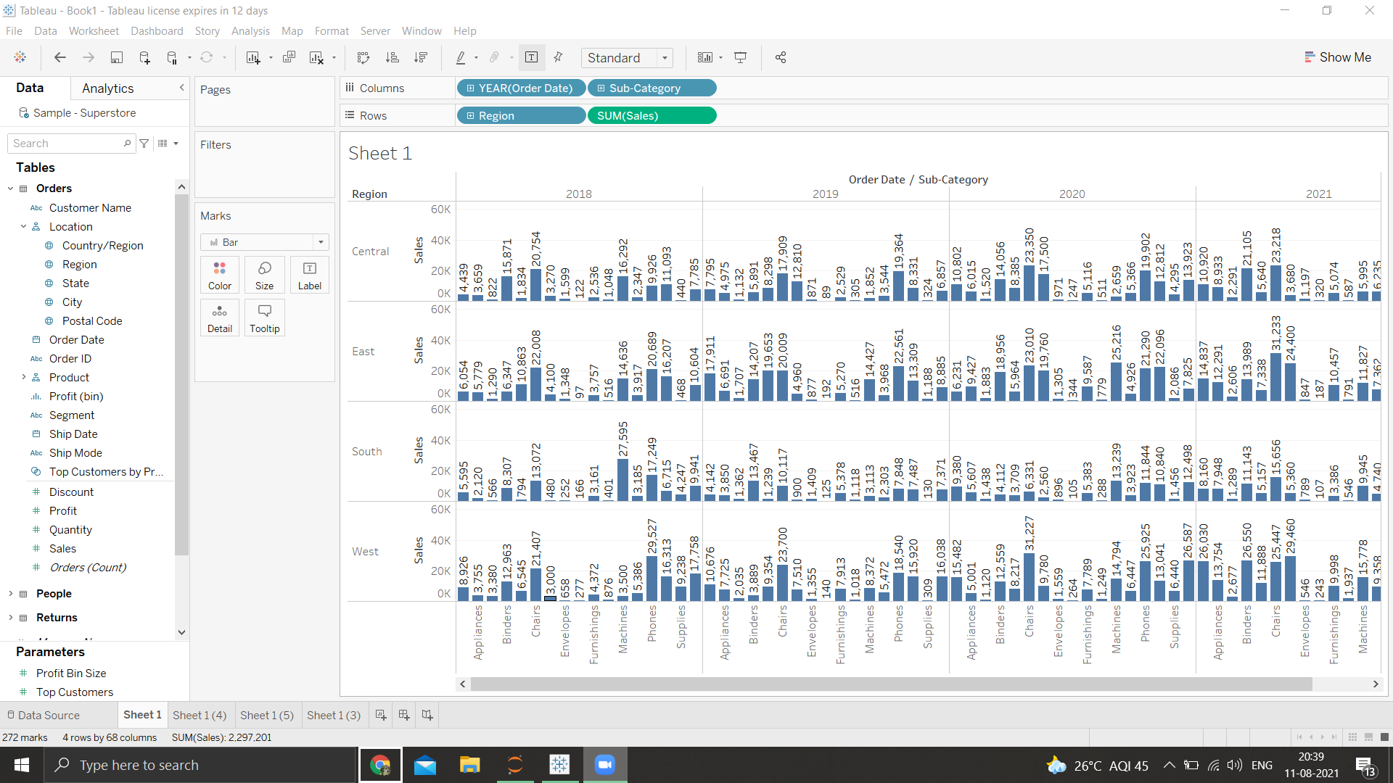
6.Show the sales region wise for every sub-category and every year

Slide 8
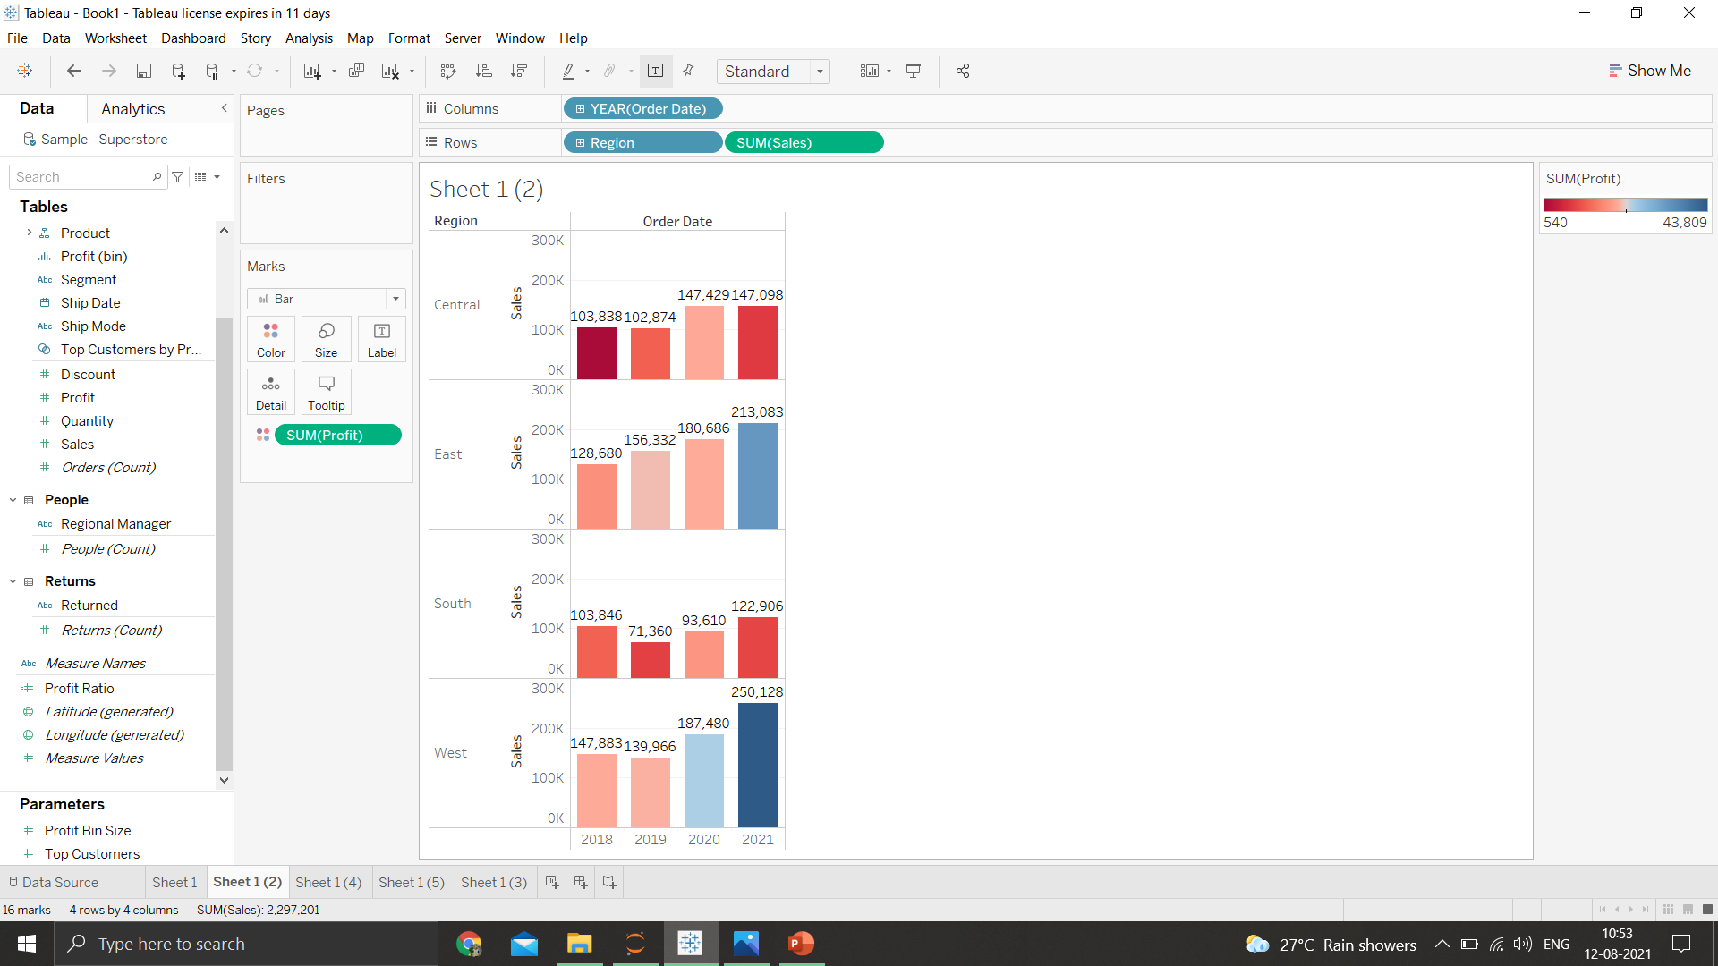
7.In which region are you reporting higher negative profit overall than in your other regions
The south is reporting the lowest profit compared to others

Slide 9
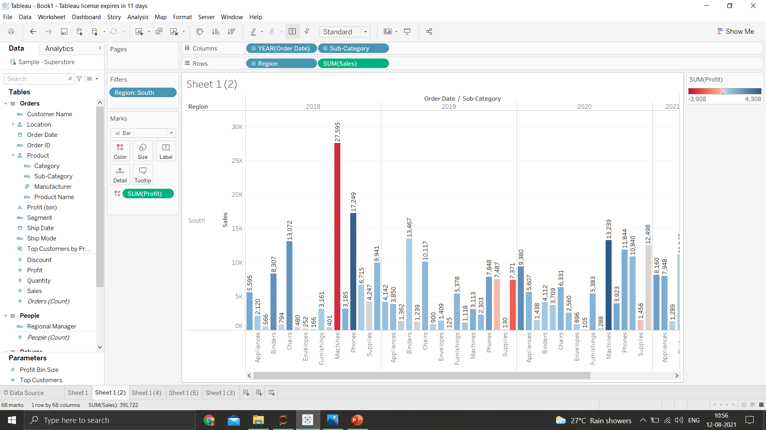
8.Show your view for sales in the south for all sub-category

Slide 10
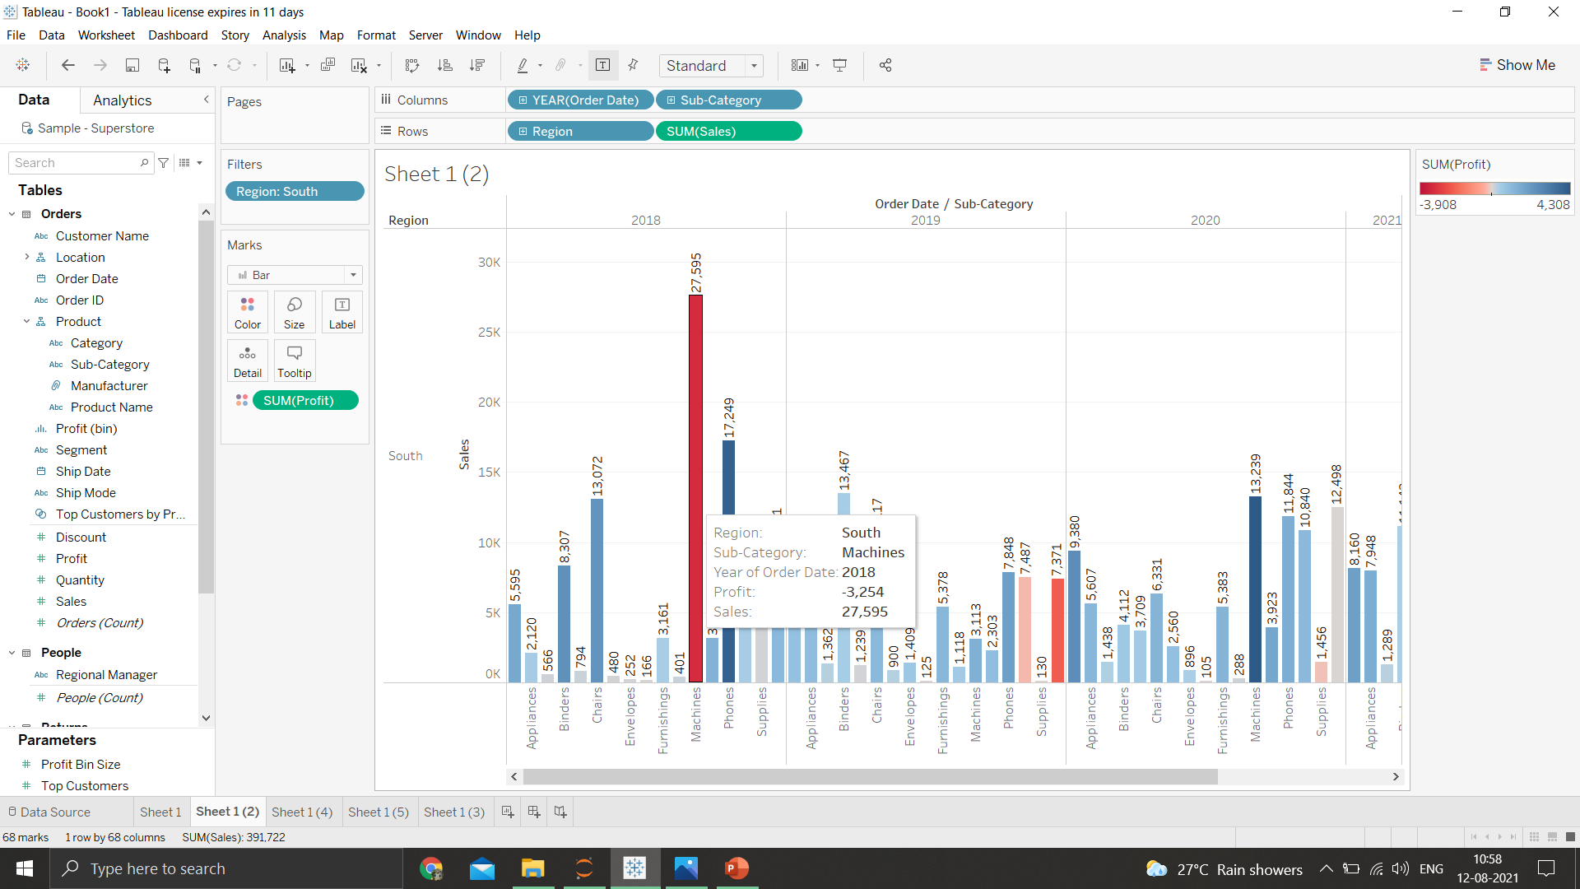
9.Which sub-category has the highest overall negative sales in the south region
Machines in 2018

Slide 11
10.Take some decisions to improve the sales in the south
As the models od the north,east & west have been making profits ,it would be a good idea to follow their business model in order to make profits in the long run
Also a deeper focus should be provided to the marketing and the advertising of the products for more sales meaning more profits

